Slide 1
Introduction
To understand the foundations of dimensional modeling in data warehousing we have designed a Entity Relationship Diagram by exploring present in FIN schema. Moreover, we have designed queries which helps up analyze functions like Rollup and Cube for the upcoming assignment

Slide 2
Assumptions
● AIRLINE_STOCKS will derived from the STOCK model. It gives us better insight and analysis of a particular section of the data
● The daily snapshot of the jet fuel prices under ENERGY_PRICES schema can be used to establish a relation between airline stock prices.
● There will be a relationship between energy prices and the stocks and vice-versa. This will be explored during further analysis when analytical queries are framed.
● The type of ruling parties in the government may be a factor in determining the price of stock. Again, this will be explored during further analysis.

Slide 3
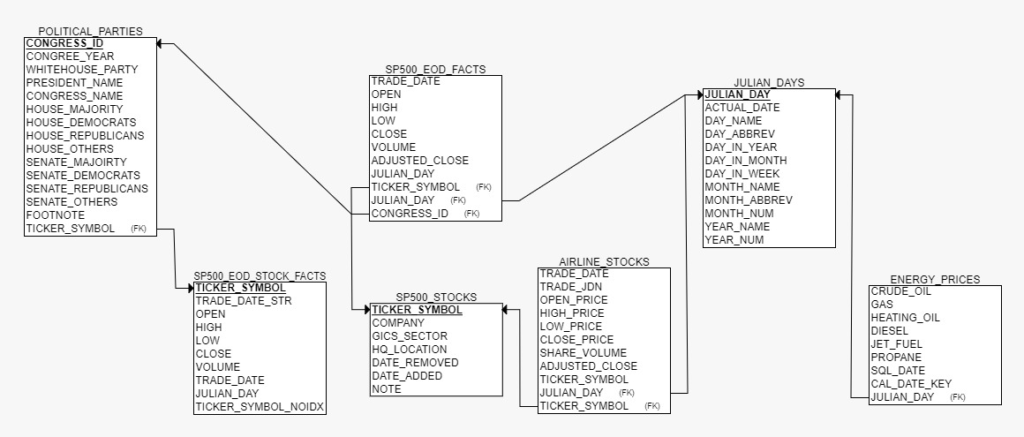
Entity Relationship Diagram

Slide 4
QUERY-1: Description: Average of open and close, max high and min of low, total volume during Single or Divided governments.
SELECT * FROM (( SELECT ‘SINGLE GOVERNMENT’ as gov_type, PPD.WHITEHOUSE_PARTY,PPD.SENATE_MAJOIRTY, PPD.HOUSE_MAJORITY,PPD.CONGREE_YEAR, ROUND(AVG(SEF.OPEN),2) AS OPEN_AVG, MAX(SEF.HIGH) AS MAX_HIGH, MIN(SEF.LOW)
AS MIN_LOW,ROUND(AVG(SEF.CLOSE),2) AS CLOSE_AVG, TO_CHAR(SUM(SEF.VOLUME),'999,999,999,999,999’)
AS TOTAL_VOLUMEFROM POLITICAL_PARTIES_DIMS PPD, SP500_EOD_FACTS SEF
WHERE PPD.CONGRESS_ID = SEF.CONGRESS_ID
GROUP BY (PPD.WHITEHOUSE_PARTY,PPD.SENATE_MAJOIRTY, PPD.HOUSE_MAJORITY, PPD.CONGREE_YEAR)HAVING PPD.WHITEHOUSE_PARTY = PPD.SENATE_MAJOIRTY
AND
PPD.SENATE_MAJOIRTY = PPD.HOUSE_MAJORITY)UNION ALL( SELECT ‘DIVIDED GOVERNMENT' as gov_type, PPD.WHITEHOUSE_PARTY,PPD.SENATE_MAJOIRTY, PPD.HOUSE_MAJORITY,PPD.CONGREE_YEAR, ROUND(AVG(SEF.OPEN),2) AS OPEN_AVG, MAX(SEF.HIGH) AS MAX_HIGH, MIN(SEF.LOW)
AS MIN_LOW,ROUND(AVG(SEF.CLOSE),2)
AS CLOSE_AVG, TO_CHAR(SUM(SEF.VOLUME),'999,999,999,999,999') AS TOTAL_VOLUMEFROM POLITICAL_PARTIES_DIMS PPD, SP500_EOD_FACTS SEFWHERE PPD.CONGRESS_ID = SEF.CONGRESS_ID
GROUP BY
(PPD.WHITEHOUSE_PARTY,PPD.SENATE_MAJOIRTY, PPD.HOUSE_MAJORITY, PPD.CONGREE_YEAR)HAVING PPD.WHITEHOUSE_PARTY <> PPD.SENATE_MAJOIRTY OR PPD.SENATE_MAJOIRTY <> PPD.HOUSE_MAJORITY
OR
PPD.WHITEHOUSE_PARTY <> PPD.HOUSE_MAJORITY)) ORDER BY CONGREE_YEAR desc;

Slide 5
QUERY-2: Description: Determine the top ten companies which traded maximum volume of stocks till now.
Query:
SELECTSS.company,SEF.ticker_symbol,SUM(SEF.volume)
AS volumeFROMSP500_STOCKS SSINNER
JOIN SP500_EOD_FACTS SEF ON SS.ticker_symbol = SEF.ticker_symbol
GROUP BY
SEF.ticker_symbol,SS.company
ORDER BY SUM(SEF.volume)
DESC FETCH FIRST 10 ROWS WITH TIES;

Slide 6
QUERY-3: Description: Yearly periodic snapshot of average of open and close, max high and min of low, total volume of stocks of companies having total volume greater than 50 Million
Query:
SELECT JD.year_num, SS.company, round( AVG(SEF.open), 2)
AS open_avg, MAX(SEF.high) AS max_high, MIN(SEF.low)
AS min_low,round( AVG(SEF.close), 2)
AS close_avg,TO_CHAR( SUM(SEF.volume), '999,999,999,999,999’)
AS total_volume
FROM SP500_EOD_FACTS SEF
JOIN SP500_STOCKS SS ON SEF.ticker_symbol = SS.ticker_symbolJOIN julian_days JD ON JD.julian_day = SEF.julian_day
GROUP BY SS.company,JD.year_numHAVINGSUM(SEF.VOLUME) > 50000000ORDER BYJD.year_num DESC,SS.company;

Slide 7
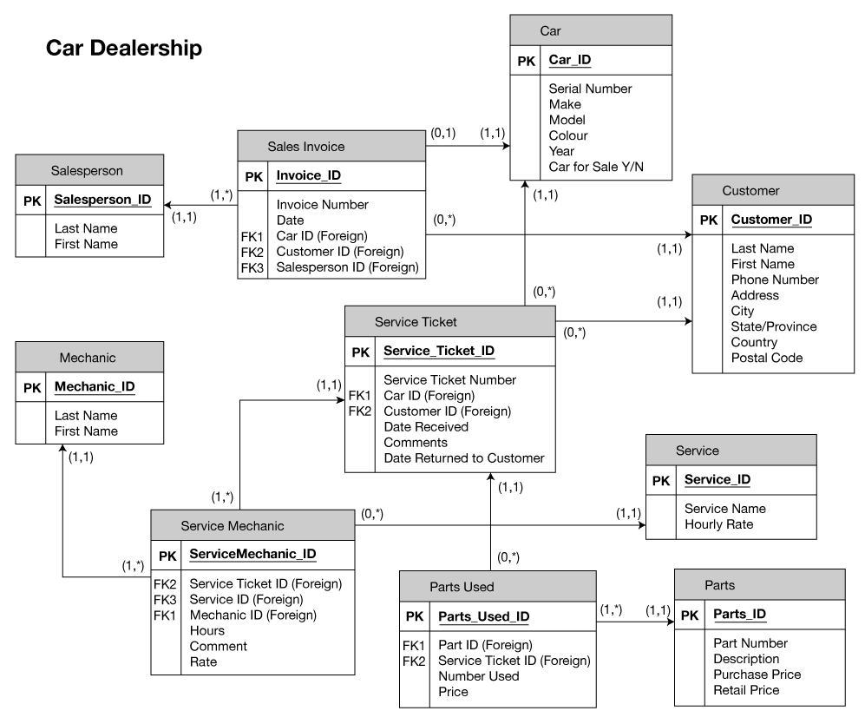
Part b:
We have taken an example of Car Dealership Sales and Services ERD Model.
This ERD has very well defined relationships with elaborate primary and foreign key defined
This model can accommodate details of Customer, Salesperson, Mechanic, Services and auto motive's parts.
This model can help understand performance of Salesperson, Mechanic and help understand problematic parts, so that we can better service later.
This model is an example of Services (Mechanical work) and Product Sales (Parts) systems working together to fulfil customer’s requirement.

